Slide 1
FYP: Presentations

Slide 2
Logistics
10’ in total
8’ presenting
2’ for questions
Each session will have 6-10 presentations
You have to attend all presentations of your session
You can ask questions at the end of each presentation (I will…)
No marks are deducted if the question is not answered
When? Last week of the semester The timetable will be posted on Moodle

Slide 3
Resources
Book: “TED Talks”, by Chris Anderson
Many great tips
Covers many aspects of a successful presentation
Contains advice from several well-known public speakers
It makes sense to skim through the book

Slide 4
Wisdom from the book
“If I had more time, I would have written a shorter letter”
Show why it matters
the question you are trying to answer
the problem you are trying to solve
the experience you are trying to share
Flesh out each point you make with real examples, stories, facts.
“Great writing is all about the power of the deleted word” It is true of speaking too. Less can be more.

Slide 5
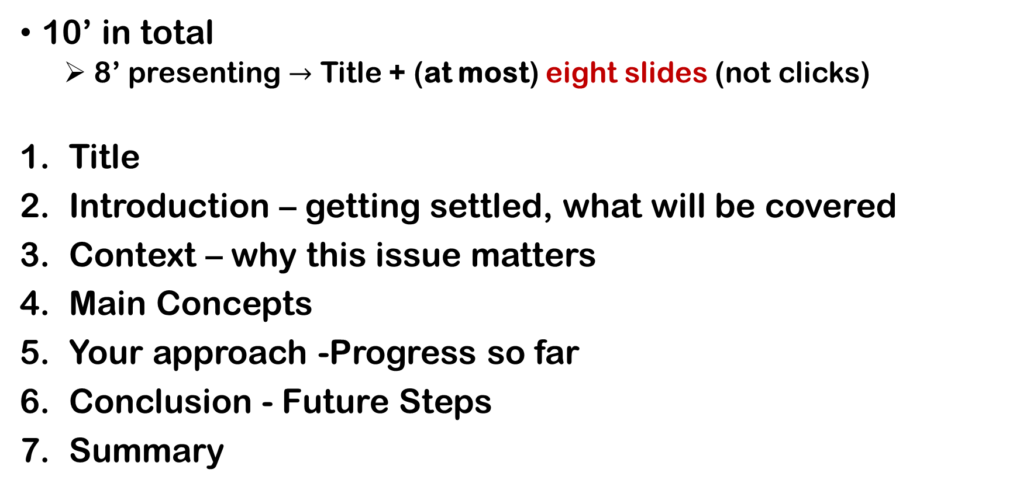
Logistics
10’ in total
8’ presenting $→$ Title + (at most) eight slides (not clicks)
Title
Introduction – getting settled, what will be covered
Context – why this issue matters
Main Concepts
Your approach -Progress so far
Conclusion - Future Steps
Summary

Slide 6
Use clicks and animations
A talk isn’t a container or a bin that you put content in, it’s a process, a trajectory.
The goal is to take the listener from where he is to someplace new.
That means trying to make the sequence so stepwise that no one gets lost along the way.
Rehearse in front of friends and acquaintances who know nothing about the topic; ask them where they get puzzled or what they wondered about, hoping that by filling those gaps for them I’d be filling the same gaps for other people.

Slide 7
Use clicks and animations in the correct way!
A talk is a process, a trajectory.
Goal: take the listener to someplace new.
Make the sequence so stepwise that no one gets lost along the way.
Rehearse in front of friends and ask them
where they got puzzled
what they wondered about
Take feedback into account!

Slide 8
Use clicks and animations in the correct way!
A talk is a process, a trajectory.
Goal: take the listener to someplace new.
Make the sequence so stepwise that no one gets lost along the way.
Rehearse in front of friends and ask them
where they got puzzled
what they wondered about
Take feedback into account!

Slide 9
Wait! Do I have to rehearse???
Yes. Rehearse. Repeatedly.
Musicians rehearse before playing.
Actors rehearse before opening the theatre doors to the public.
Why shouldn’t you? A presentation is a performance!!
Bad talk/presentation = audience suffers until it ends!
Question
So, Argyris, did you rehearse before giving us this lecture???

Slide 10
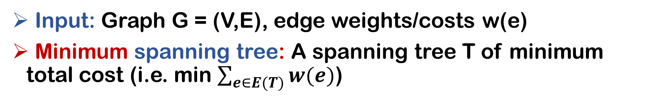
Use pictures and diagrams!
Input: Graph G = (V,E), edge weights/costs w(e)
Minimum spanning tree: A spanning tree T of minimum total cost (i.e. min $\sum_{e∈E(T)}{w(e)}$)
3
7
f
3
f
3
7
f
7
4
g
5
4
5
g
4
g
d
5
5
d
3
d
5
5
3
3
4
4
4
c
i
c
2
i
c
i
3
2
3
3
2
b
9
a
b
4
9
b
9
a
4
a
4
3
3
3
3
3
cost: 28
3
cost: 22
h
h
h

Slide 11
Use the right font and background
The actual font does not matter,
as long as it is easily readable: example, example, example
it has the right size: example, example, example
it has the right colour: example, example, example
Use a background with appropriate contrast
Example
Example
Example

Slide 12
Imagine 10’ like this….

Slide 13
FAQs
Can I have a script?
Yes, as long as you do not read the whole thing!
Should I have a handout?
One page handout is a nice idea!
Is it a good idea to have a live demo of my code?
Yes, as long as it is a recorded video!
30” tops, use OBS, edit the gaps (Dave’s wisdom)
Are there any penalties for short presentations?
It is a shame not to use your time (and inspire your colleagues)
How about long ones?

